Slide 1
AIM
Decision
forces
teex

Slide 2
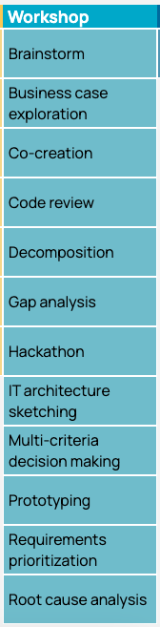
FORCES
A force is any aspect of an architectural problem arising in the system or its environment ( operational, development, business, organizational, political, economic, legal, regulatory, ecological, social, etc.), to be considered when choosing among the available decision alternatives.
Decision Forces are a way of “Multi-criteria decision making”, part of the ICT Research Methods Pack.

Slide 3
Frmwrk for Architecture Decisions
Validate consistency & completeness
Perform impact analysis
Understand decision relationships
Get overview
Understand system evolution
Find decisions changed after last review
Analyze chronological sequence
Extract reusable decision paths
Decision
Relationship
View
Decision
Chronological
View
Decision
Rationale
Decision
Stakeholder
Involvement View
Decision
Forces
View
Identify stakeholders involved in decisions
Identify stakeholders who have the most impact on a system
Understand a stakeholder‘s function/ significance in a project
Understand all motivating aspects driving
decisions
(van Heesch, Avgeriou, Hilliard, 2012)
Notes:
3
There is not one way of documenting decisions that satisfies all concerns related to decisions! Hence each decision viewpoint addresses a number of concerns

Slide 4
Frmwrk for Architecture Decisions
Validate consistency & completeness
Perform impact analysis
Understand decision relationships
Get overview
Understand system evolution
Find decisions changed after last review
Analyze chronological sequence
Extract reusable decision paths
Decision
Relationship
View
Decision
Chronological
View
Decision
Rationale
Decision
Stakeholder
Involvement View
Decision
Forces
View
Identify stakeholders involved in decisions
Identify stakeholders who have the most impact on a system
Understand a stakeholder‘s function/ significance in a project
Understand all motivating aspects driving
decisions
(van Heesch, Avgeriou, Hilliard, 2012)
Notes:
4
There is not one way of documenting decisions that satisfies all concerns related to decisions! Hence each decision viewpoint addresses a number of concerns

Slide 5
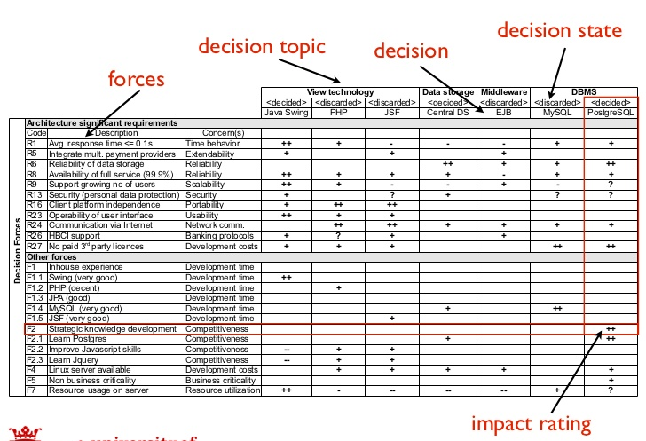
Decision Forces
(van Heesch, Avgeriou, Hilliard, 2012)
Notes:
5
De "view" bevat sowieso altijd alle forces-"tabellen". Wat modellen betreft kun je daarvoor kiezen op per decision-group een model aan te maken waarin je alle opties toont, of je kunt ervoor kiezen om een groot model aan te maken wat alles bevat. Er hoort wel altijd ook een model te zijn wat in ieder geval alle gekozen opties uit alle decision groups bevat omdat je anders niet kunt checken of alle ASRs door de gekozen opties voldoende (en niet conflicterend) geadresseerd zijn.

